Slide 1


TRUTHHUARD-FAKE NEWS DETECTION AND VERIFICATION Tool
Presented By : R.Mounika
Presented To : V.Manjuladevi

Slide 2
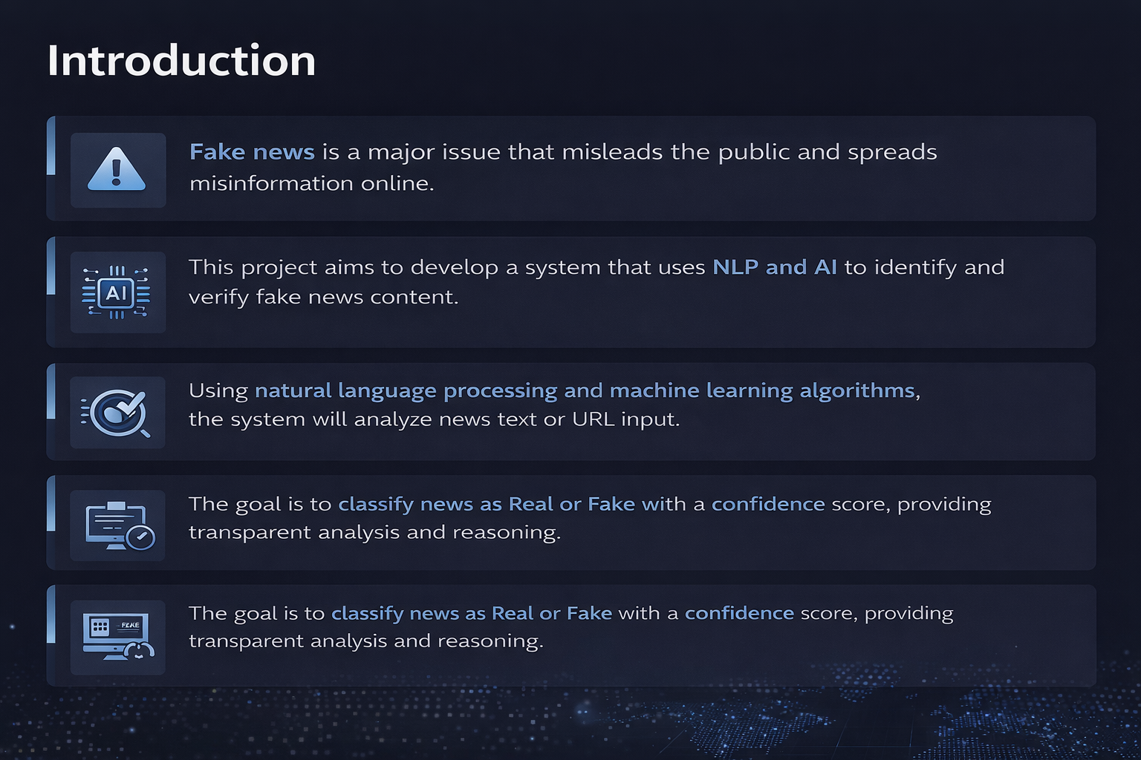

INTRODUCTION

Slide 3
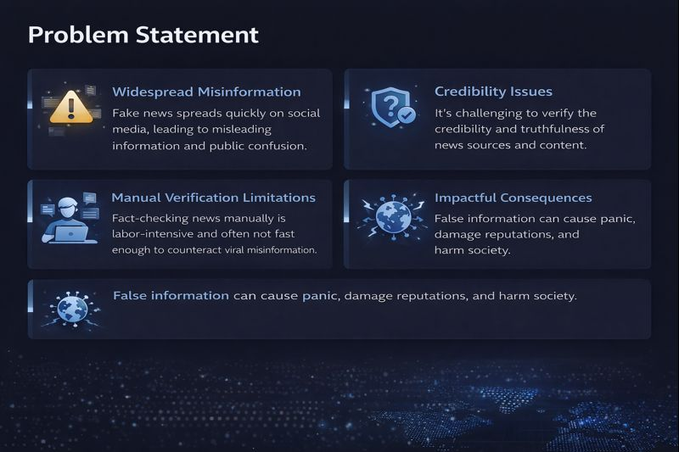
PROBLEM STATEMENT

Slide 4
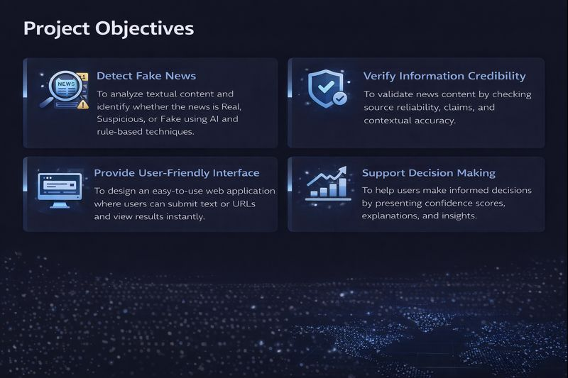
PROJECT OBJECTIVES

Slide 5
Outcomes
Fake News Identification
Successfully identifies fake news from user-provided text or URLs.
Accuracy & Reliability
Provides reliable classification results using AI and NLP techniques.
User-Friendly Interface
Simple and interactive web interface for easy usage by non-technical users.
Real-Time Analysis
Delivers quick analysis results with confidence scores.

Slide 6
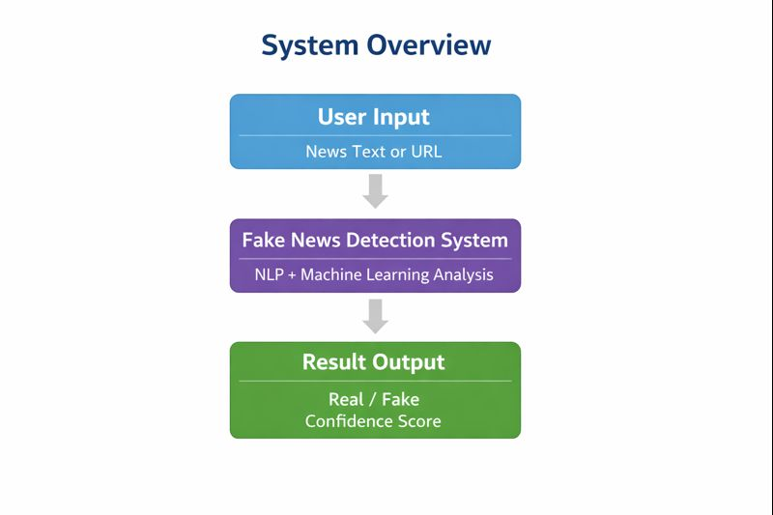

SYSTEM OVERVIEW
User Interaction
Users enter news text or a URL through the web interface.
⚙ Content Processing
The system cleans and processes the input using NLP techniques
🤖 Fake News Detection
AI model analyzes the content and classifies it as Real or
Fake.
📊 Result Display
Results are shown with confidence scores and explanations.

Slide 7
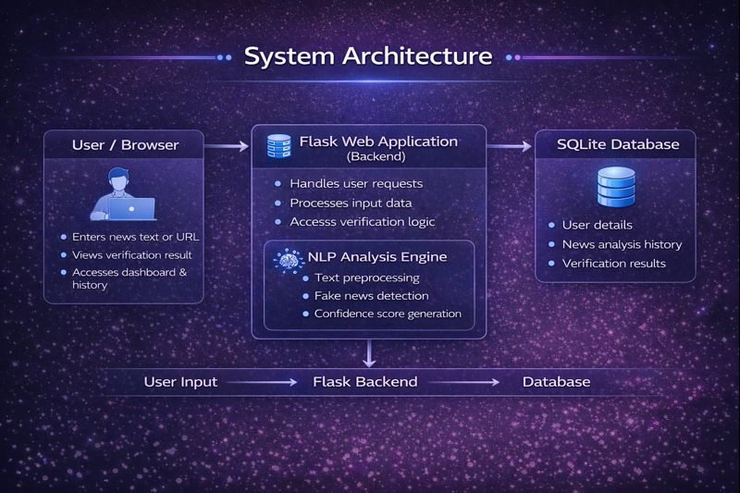
SYSTEM ARCHITECTURE

Slide 8




TECH STACK USED
NLP Technologies
Machine Learning Models
Used for preprocessing and understanding news content using tokenization, stop-word removal, lemmatization, and entity recognition with spaCy and NLTK.
Transformer-based models such as BERT and RoBERTa analyze contextual meaning to classify news as Real, Suspicious, or Fake.
Fact Checking & Database
Web & Backend Stack
Uses external fact-checking APIs and structured databases to validate claims and store analysis results securely.
Developed using Flask or FastAPI with JWT authentication and scalable deployment support.

Slide 9
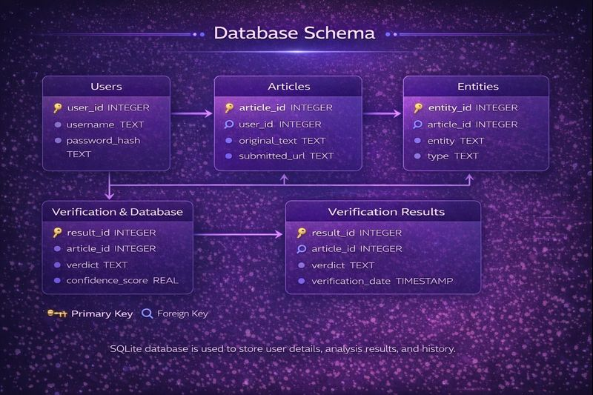
DATABASE SCHEMA

Slide 10
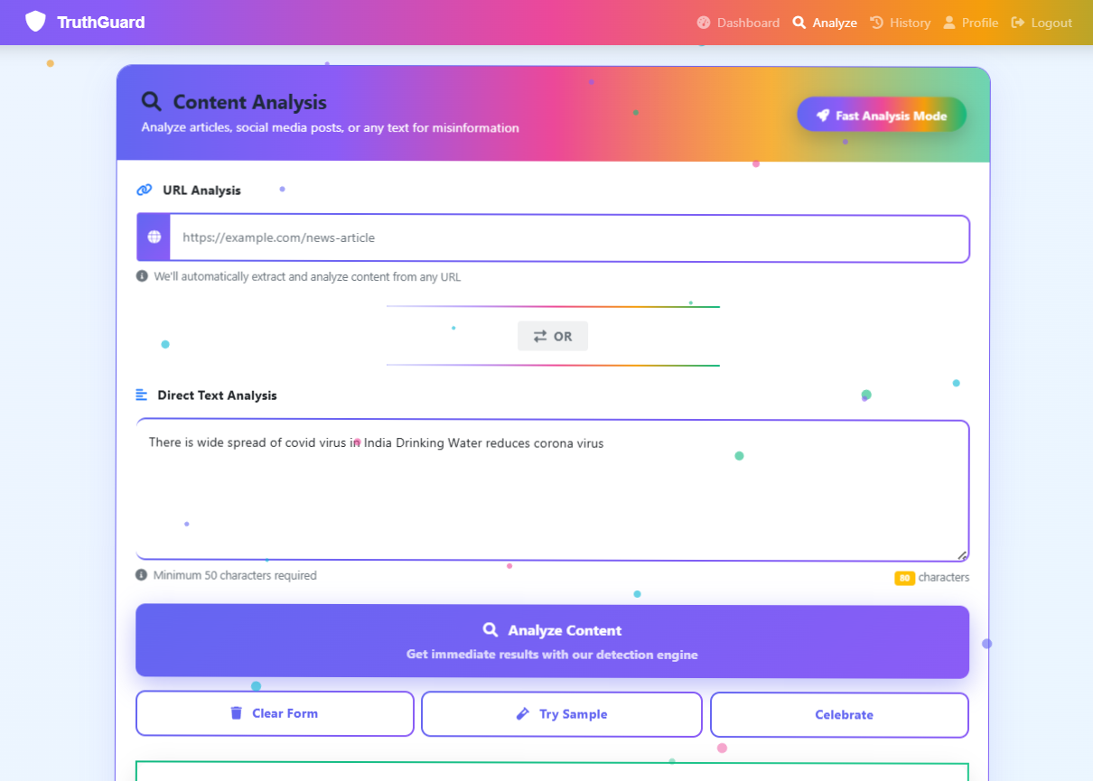

Sample Output

Slide 11
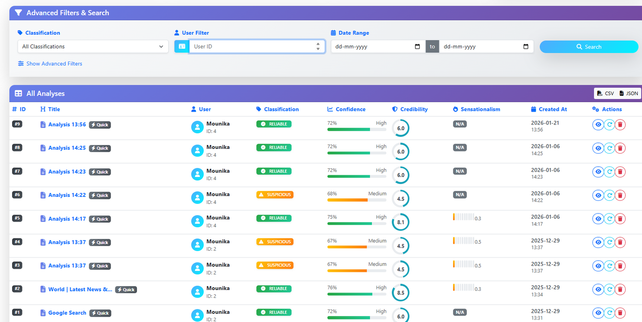
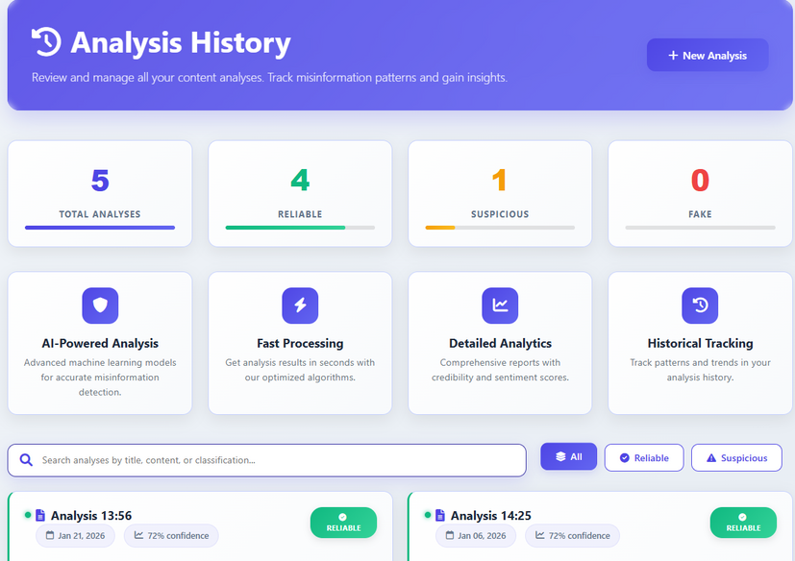

Slide 12
CONCLUSION
The AI-Powered Fake News Detection & Verification Tool successfully analyzes news content using Natural Language Processing and AI models to identify Fake, Real, and Suspicious information.
The system provides confidence scores and explanations, helping users make informed decisions and reduce the spread of misinformation.
Key Highlights:
Accurate fake news classification
User-friendly web interface
AI-driven content analysis
Secure and scalable architecture

Slide 13




FUTURE ENHANCEMENTS
Multilingual Support
Enable fake news detection in multiple regional and international languages.
Social Media Integration
Analyze news directly from platforms like Twitter, Instagram, and Facebook.
Advanced Fact-Checking APIs
Integrate real-time fact-checking services for improved accuracy.
Mobile Application
Develop an Android/iOS app for easy and wider accessibility.

Slide 14


